Slide 1
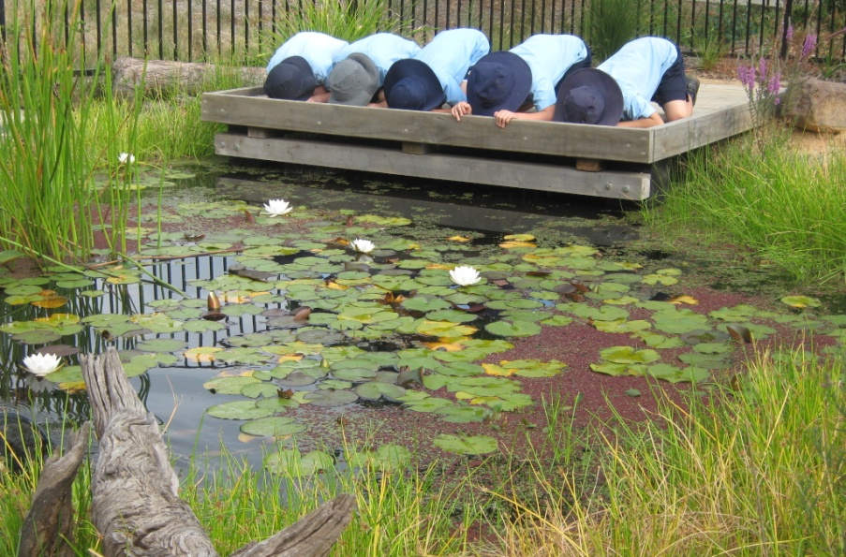

Endangered Ecosystem Garden
STRATHAIRD PRIMARY SCHOOL
MAY 2012
Where are those taddies?
Perhaps they’ve turned into frogs!

Slide 2
The journey begins…
From 2009 –
  Sustainability became a school priority and a whole school focus.
  We employed a fulltime Sustainability Teacher.

Slide 3
The journey begins…
Our school leaders wanted to develop a large sustainability project that would:
  Educate children about the environment.
  Educate children about ecosystems, how they function, how species become endangered and the importance of looking after our world.
  Inspire in children a love of nature and the environment.
  Inspire children to become active, global citizens who are advocates for the environment and a sustainable world.

Slide 4
The journey begins…
Our school leaders had a vision to develop a special garden, that would re-establish an ecosystem that is now endangered in the City of Casey.
Ideas were gathered from the School community:
  Drawings and ideas from students.
  Sharing of ideas from staff, parents and school council.
  Ideas from the City of Casey.

Slide 5
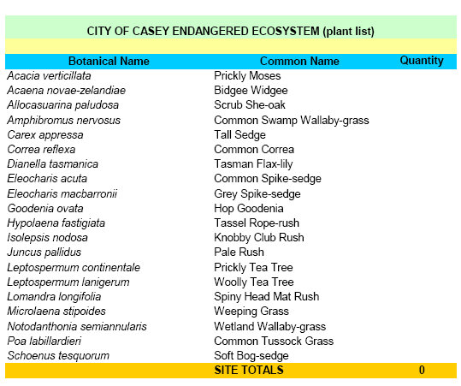
The journey begins…
The City of Casey helped us to identify an endangered ecosystem.

Slide 6
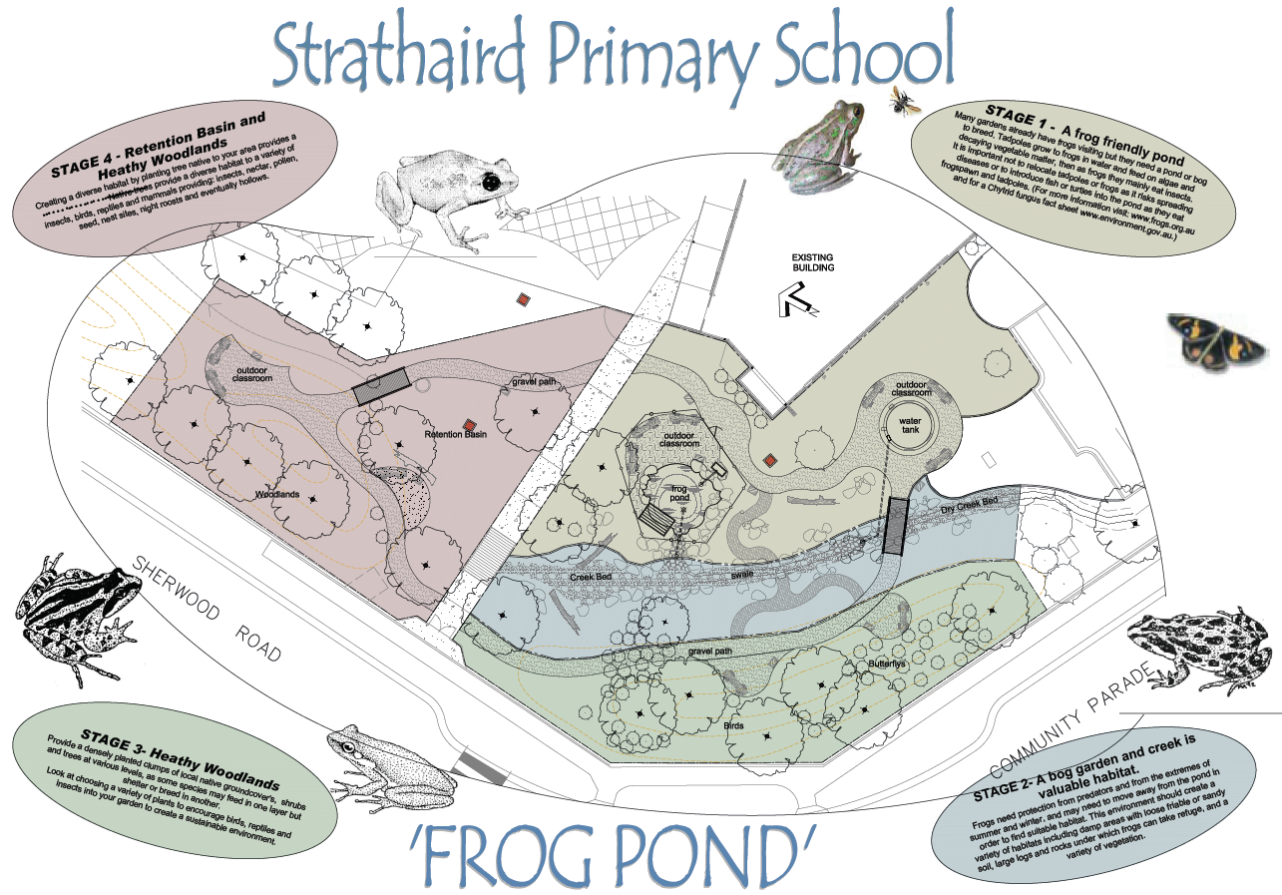
The journey begins…
  Our ideas were integrated into a professional drawing of the garden.

Slide 7
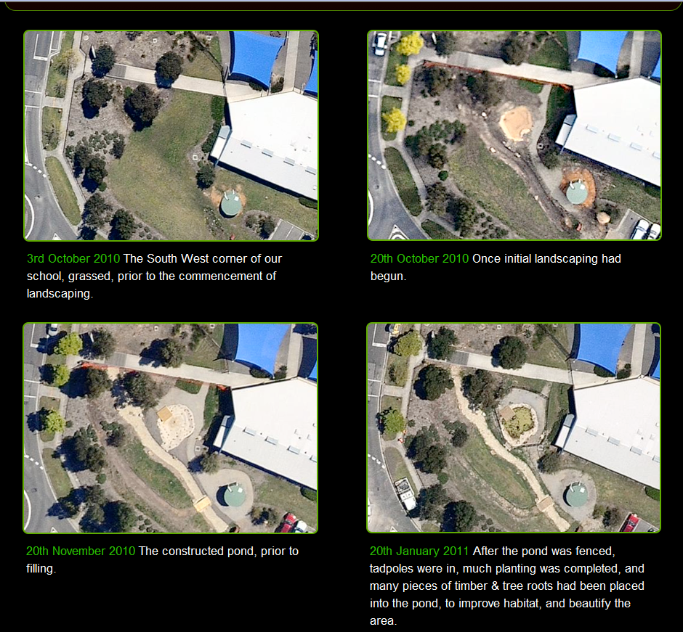
Endangered Ecosystem Garden
Establishing the
garden in stages
  The frog pond

Slide 8
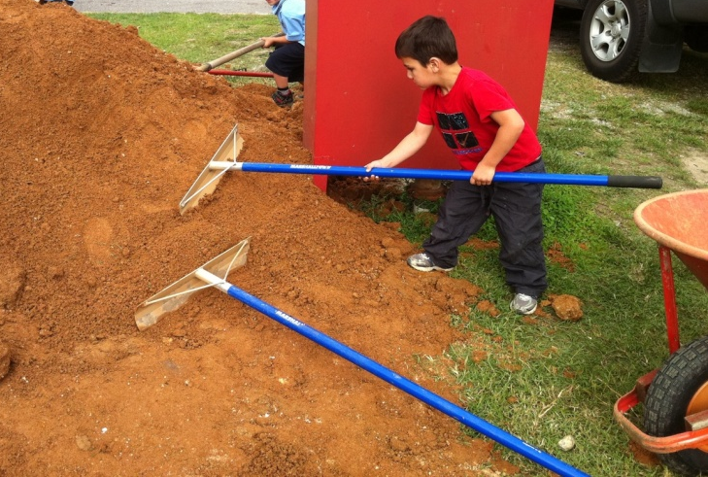
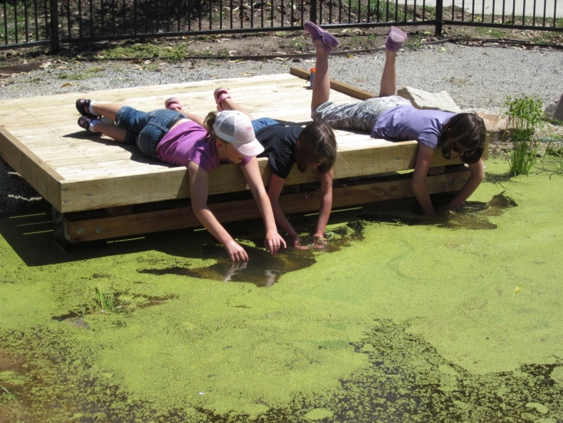
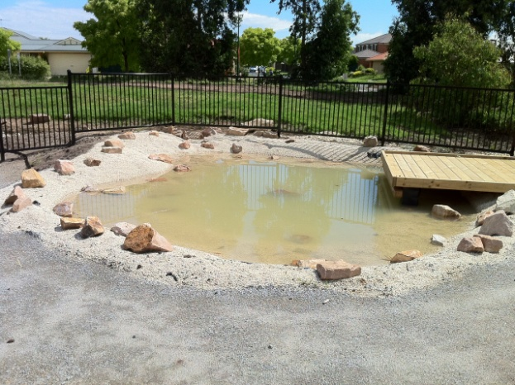
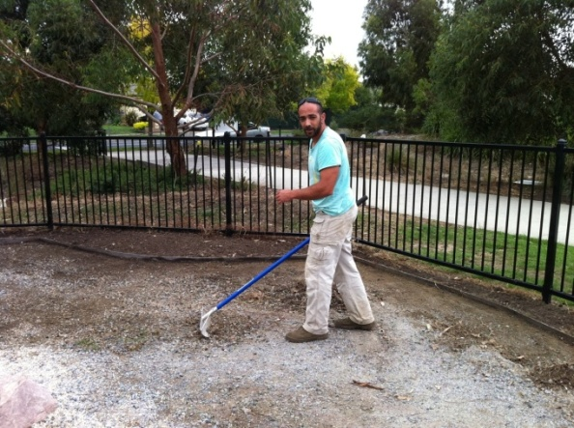
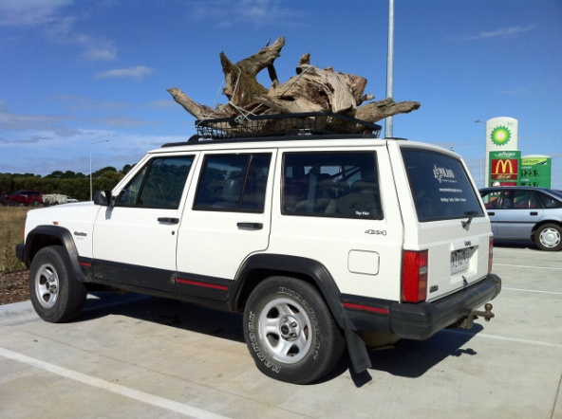
Our whole school learning program:
  We had many fantastic parents and children helping us to make the frog pond.
.

Slide 9
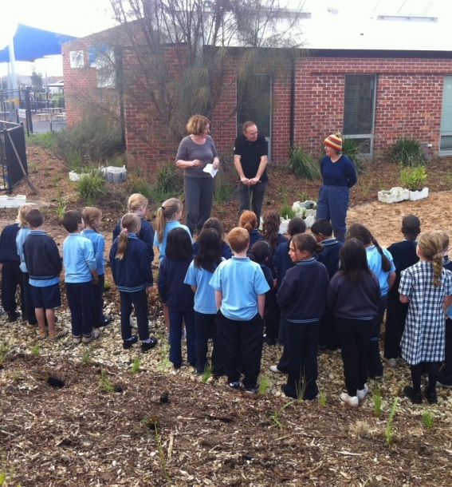
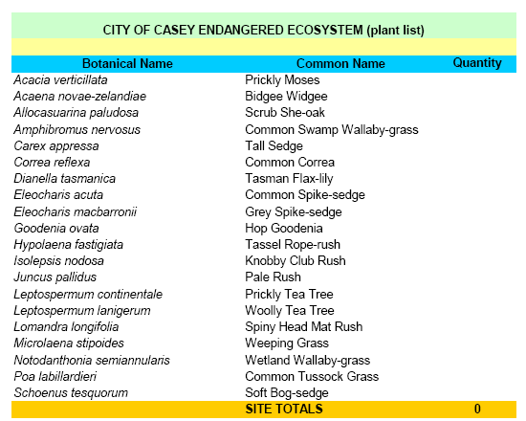
Endangered Ecosystem Garden
  Vivian from the Maryknoll Indigenous Nursery grew our plants from seeds and cuttings. Many seeds are rare and needed to be gathered from reserves.
  Many of the plants are bird and butterfly attracting plants.

Slide 10
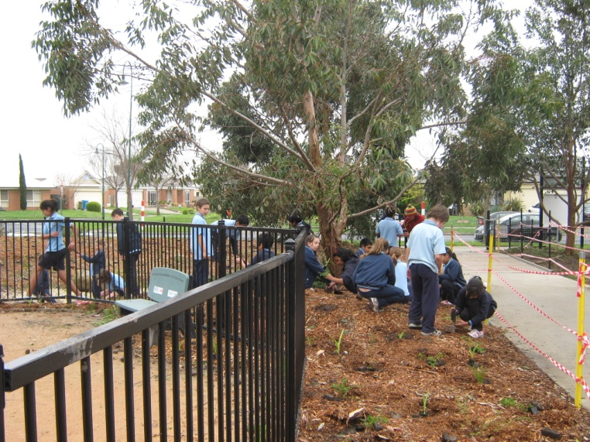
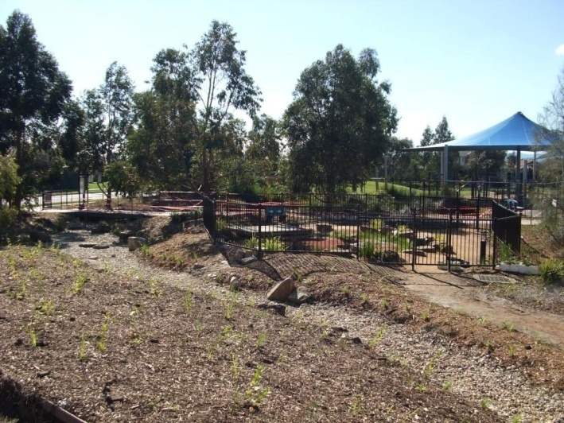
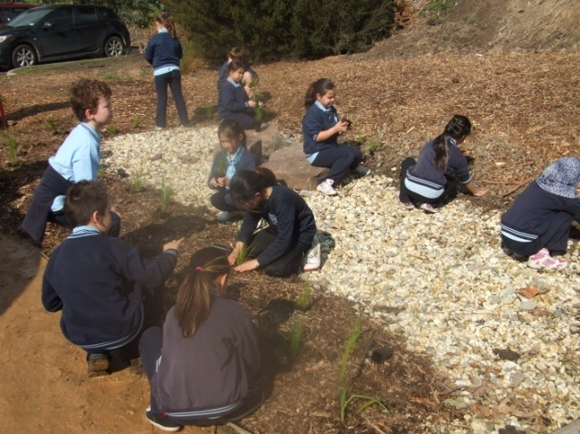
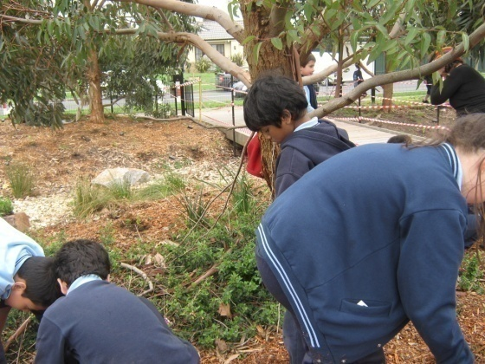
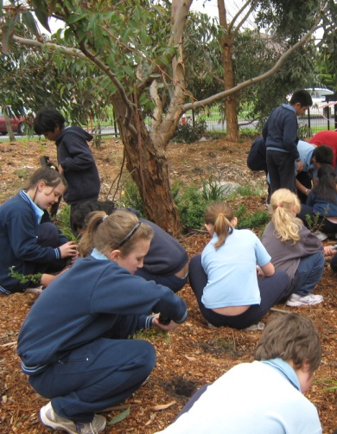
Endangered Ecosystem Garden
It was a huge planting project
  870 students, teachers and parents
  planted over 3500 plants in April and
  June 2011

Slide 11
Our whole school learning program:
Our endangered ecosystem garden is linked to our classroom and specialist learning programs.

Slide 12
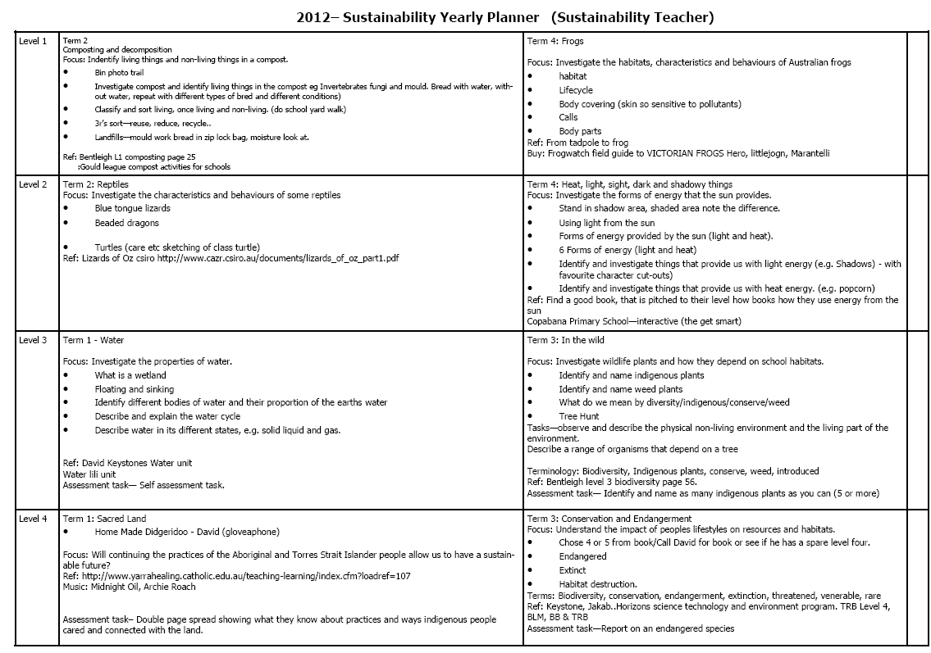
Our whole school learning program:

Slide 13
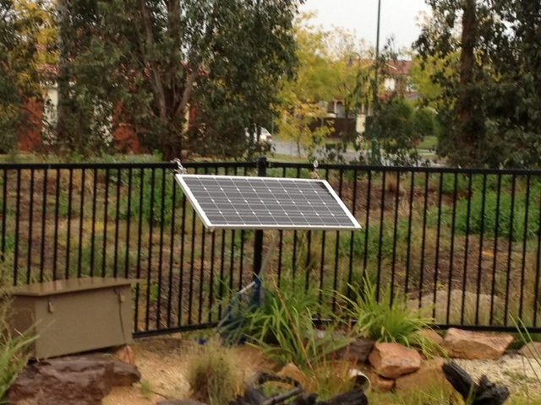
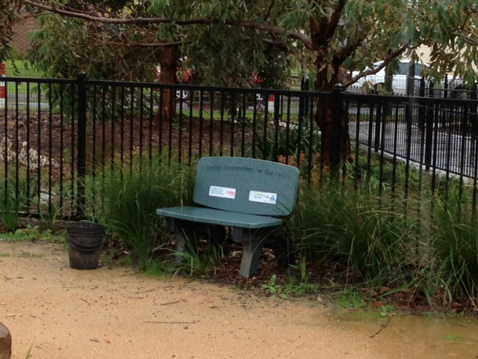
Maximizing the learning opportunities:
  Solar power to drive the pond aerator – How does that work?
  Bench made out of recycled plastic bags – How can a bench be made our of plastic bags?

Slide 14
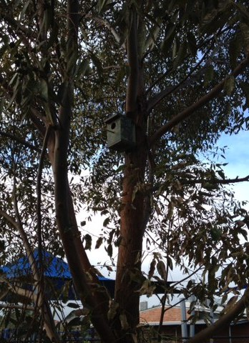
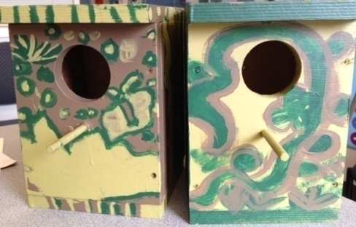
Maximizing the learning opportunities:
  Bird boxes for our garden, assembled and painted by our students.

Slide 15
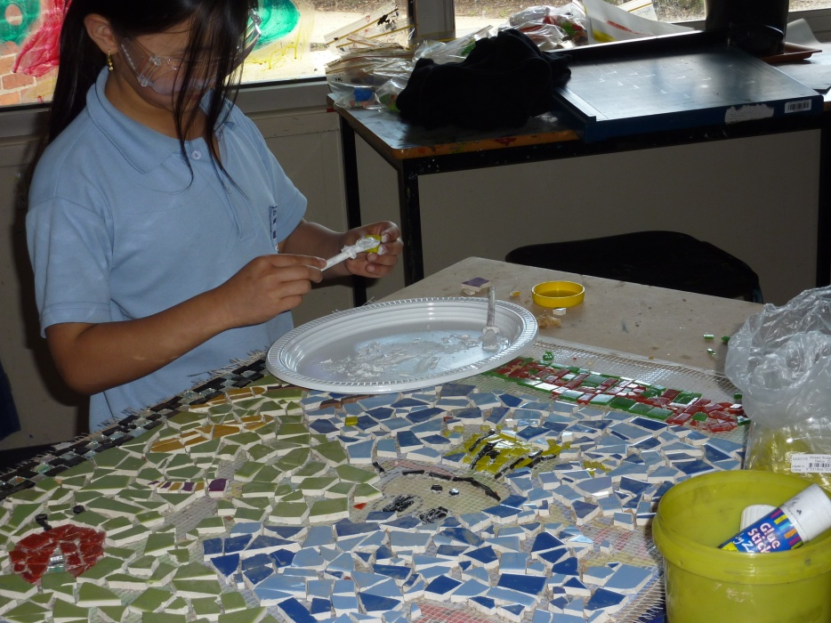
Maximizing the learning opportunities:
  Mosaic feature display designed and made by our students.

Slide 16
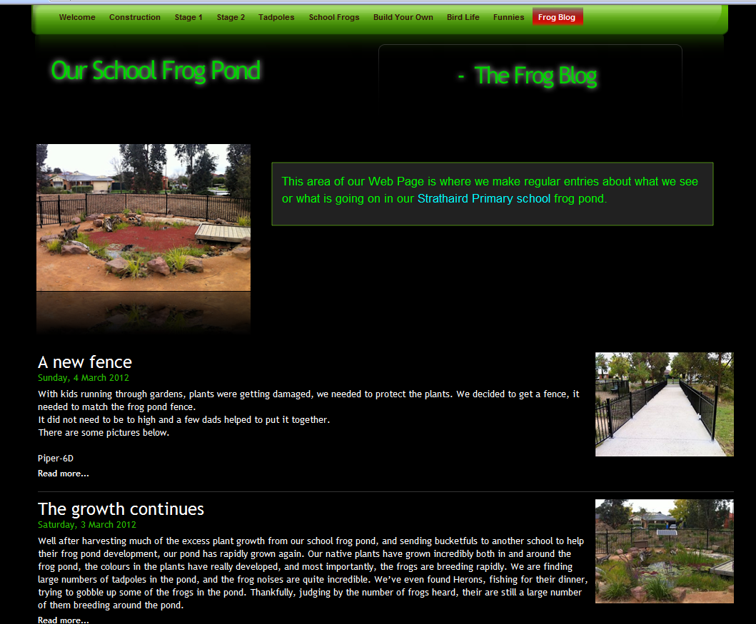
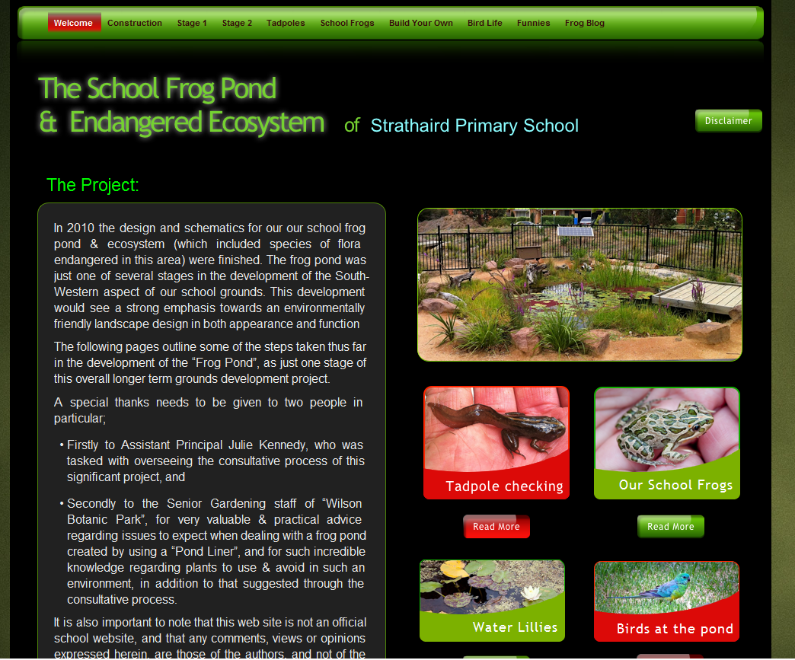
Maximizing the learning opportunities:
  Our School Frog Pond website with regular blogs and photos – follow the link at www.strathairdps.vic.edu.au
Blog maintained by Piper Year 6

Slide 17
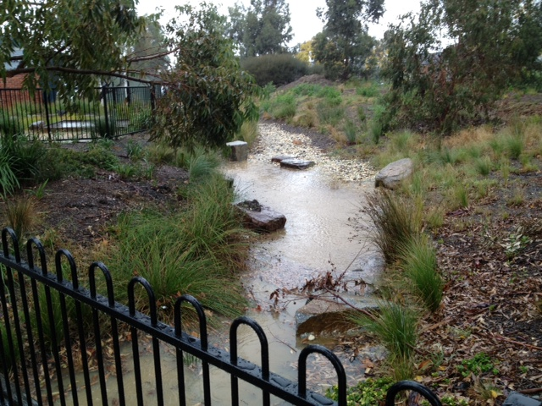
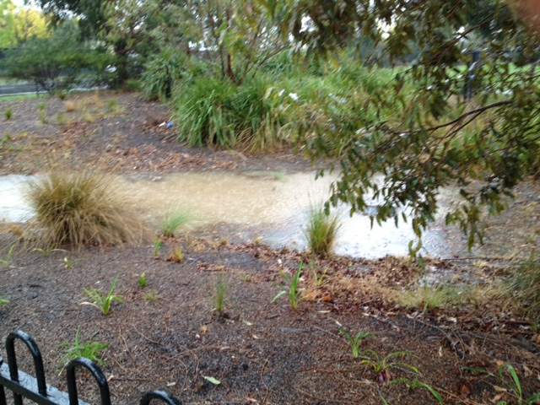
Endangered Ecosystem Garden
Our dry creek
bed is sometimes
a REAL creek and
the frogs love it!

Slide 18
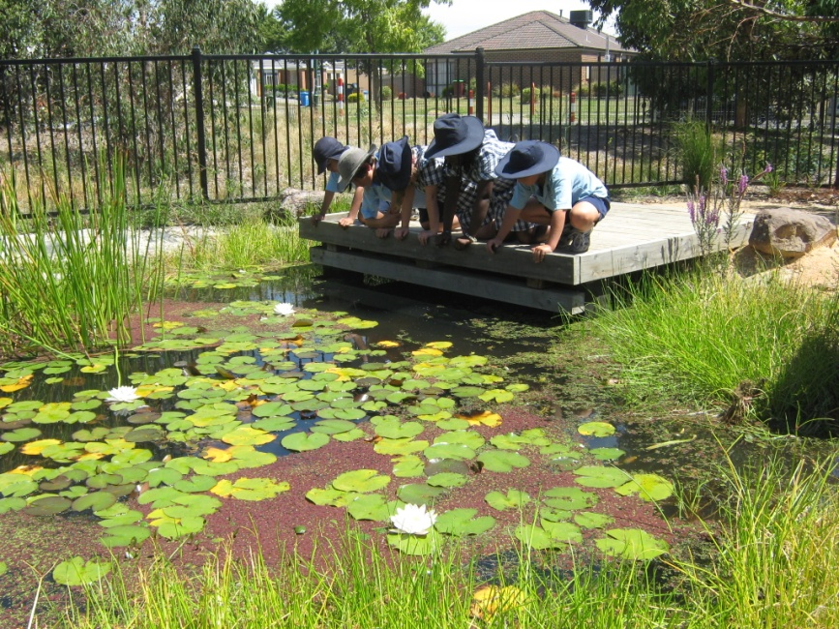
Endangered Ecosystem Garden
Many thanks to the staff, students and parents of Strathaird Primary School for their passion and commitment to the environment and particularly our school environment.

Slide 19



Endangered Ecosystem Garden
We are a small part of a big world but every little bit helps and together we can make a difference towards a sustainable global future.

