Slide 1
‘My earthship’ deSIGN
by harrison jasper
7 September 2015

Slide 2
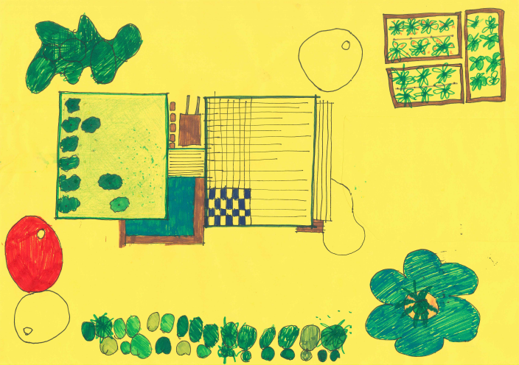
SITE & GARDEN PLAN
Indigenous plants for natural habitats
Rain water
Bike parking
Edible garden with compost and green house
Green roof and green wall
External deck from recycled materials
Solar hot water
& solar panels
Frog Bog
Rain water tanks
Indigenous plants for natural habitats

Slide 3
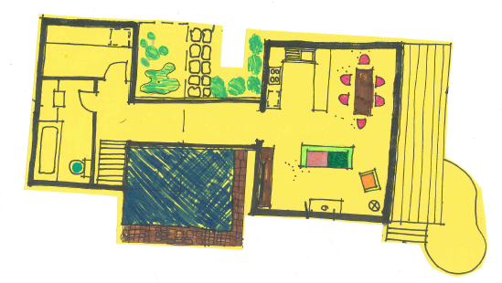
Ground floor PLAN
Indigenous plants
Energy efficient Appliances
Laundry
Deck
Bath
Double Glazing
Kitchen
Dining
Lounge
Swimming Pool
Recycled materials

Slide 4
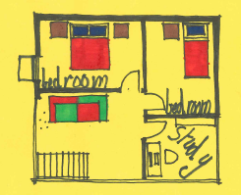
FIRST floor PLAN
Mud bricks with straw
Wool carpets in bedrooms & study
Double glazed windows with thick curtains and pelmets
Stairs from recycled materials

Slide 5
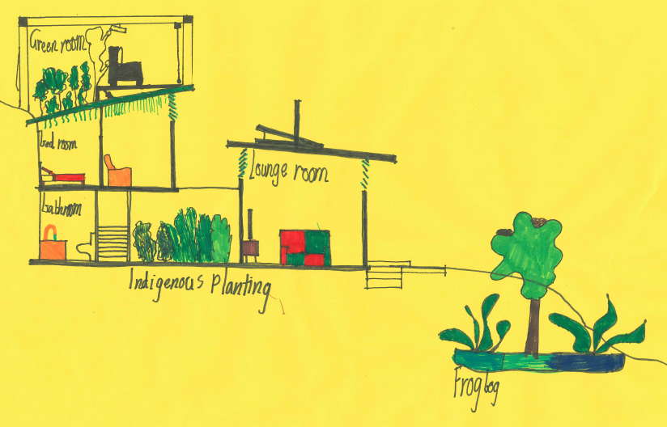
SECTION
Green roof
Louvre windows
Stairs from recycled materials

Slide 6
HOUSE (inside) SUSTAINABLE DESIGN FEATURES
Wood heating heats the house and hot water during winter.
Louvre windows- for cross ventilation
Double glazed windows
Wool carpet- made from natural fibres
Furniture made from sustainable materials
Water efficient tap ware
Recycled water for toilet (grey water)
Energy efficient appliance
Energy efficient light fittings
Thick curtains
Waste management- including recycling
Draught proofing

Slide 7
HOUSE (outside) SUSTAINABLE DESIGN FEATURES
Recycled materials reduce the amount of waste. They reduces energy to produce raw materials.
A green roof and a green wall can provide a habitat for wildlife and collect rain water.
Solar panels allow you to use less energy. They give you natural energy from the sun.
Indigenous planting
Frog bog
Plant green house made from recycled bottles for the walls
Recycled water plant for toilets
Fresh rain water tank
Solar hot water
Bike tracks
Edible garden and compost
Chickens

Slide 8
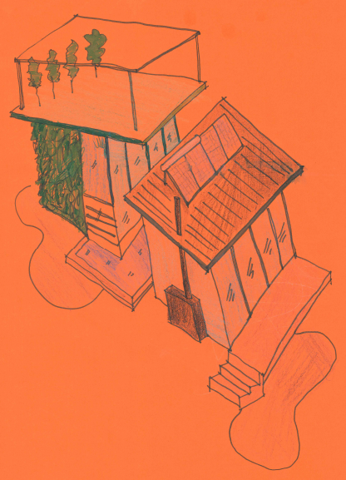
MY EARTH SHIP DESIGN
Green roof and wall
Solar hot water and solar panels
Double glazed windows with thick curtains and pelmets
Swimming pool
Wood heating
Deck made from recycled materials
Mud bricks with straw

Slide 9
For sale
Looking to live a sustainable lifestyle? Look no more! This is the perfect house for you.
It is a fantastic sustainable house with an amazing green roof and adjoining green wall for night movies and star gazing. The ground floor contains a spacious kitchen, bathroom with solar hot water, open plan living including the comfort of wood heating. Second floor features 2 bedrooms, study and relaxing space with full cross-ventilation. The walls are made from mud and straw, making them fire resistant.
Externally, it has a well planned landscaping including a frog bog with lots of natural habitat and animals to listen to at night. The area is surrounded by indigenous tree planting and bike paths. Secure bike parking is available.
Enjoy making home cooked food from the well established vegetable garden. Enjoy relaxing on the deck while the kids have fun climbing the trees.
Come look and move in.
$$$$$$$$$$$$$$$$$

Slide 10
THE END

