Slide 1
AuSSi Litter Audit Upper Primary Valkstone Primary School East Bentleigh
Conducted by Team Green
17th May 2016

Slide 2
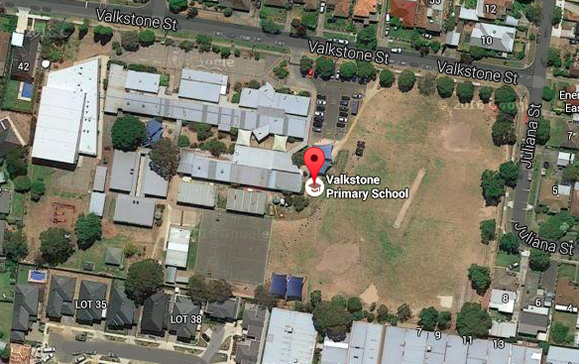

Slide 3
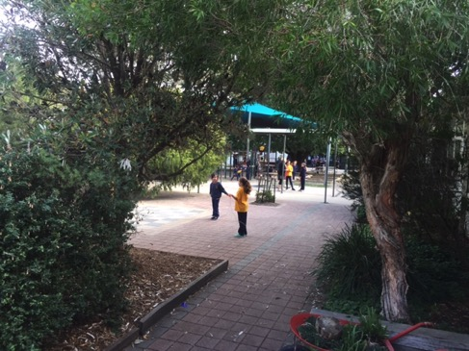
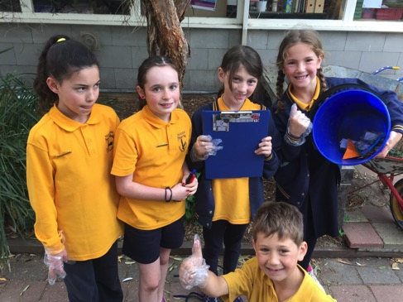
Section 1 – Middle Total No.23
Three most common items: Lolly pop stick, small pieces paper, plastic wrappers
Where was the litter densest: near grade 5 classrooms
What percentage could be recycled: 90%
What percentage could be composted: 0%
What percentage of the litter should be placed in the rubbish bin: 10%

Slide 4
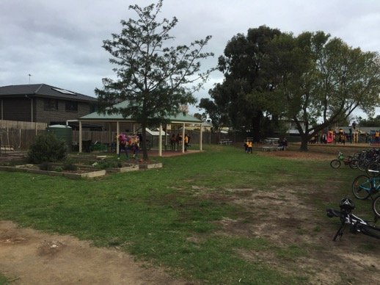
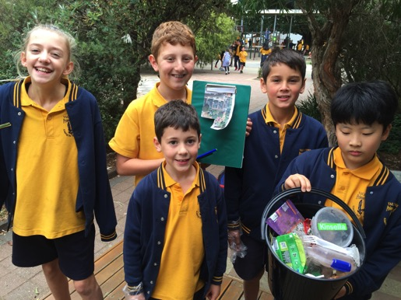
Section 2 – Chickens Total No. 24
Three most common items: plastic drink bottle, lids and wraps
Where was the litter densest: chicken coop
What percentage could be recycled: 85%
What percentage could be composted: 0%
What percentage of the litter should be placed in the rubbish bin: 15%

Slide 5
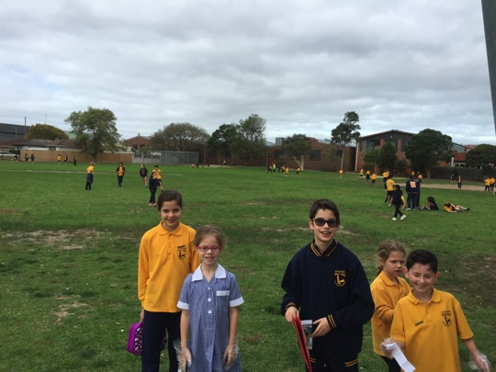
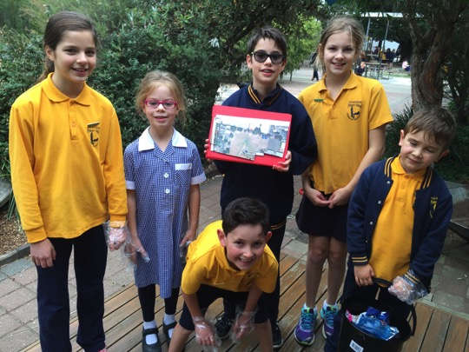
Section 3 Oval Total No. 25
Three most common items: Sheets of paper, tissue, plastic wrap
Where was the litter densest: far corner
What percentage could be recycled:90%
What percentage could be composted: 0%
What percentage of the litter should be placed in the rubbish bin: 10%

Slide 6
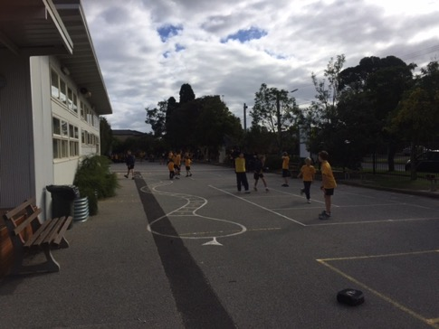
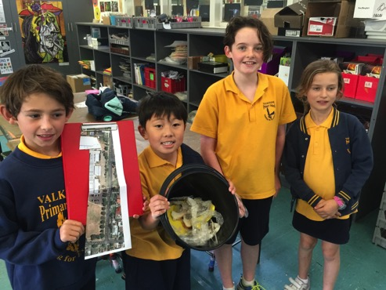
Section 4 Front of School Total No. 25
Three most common items: small paper, plastic wrappers
Where was the litter densest:fence near sensory garden
What percentage could be recycled: 90%
What percentage could be composted: 2%
What percentage of the litter should be placed in the rubbish bin: 8%

Slide 7
Bar Graph

Slide 8
Total number pieces of rubbish: 97 Which section had the greatest amount of litter? Section 3 and 4 What were the 3 most common items overall? Plastic wrapper, paper lolly pop sticks What percentage could be recycled? Average of 90% What percentage could be composted? 2% as there was low amount of food scraps due to buckets in classrooms What percentage of the litter should be placed in the rubbish bin: Estimated average of 10%

Slide 9
REFLECTION
Why do you think there is so much litter in certain areas of the school grounds?
Unseen areas where people think they can drop their rubbish
Where people sit and eat
No bins in these areas
What is it about these areas that attracts litter?
Falls out of pockets
Wind

